Slide 1
Data Analysis and Visualization
Group 21
Daniel Clepper, Gaomingyu Fan, Darren Tung, Barry Yao, Julia Mengxuan Yu

Slide 2
Cleaning and sampling
Microbusiness density(MBD) shape: (128535, 7)
Census data shape: (3142, 26)
0 missing values in MBD data, 14 missing values in Census data
Missing values imputed using mean
2 year lag
Census percentage values according to 2 years before MBD observation date saved as given observation’s percentages (i.e. pct_college, pct_foreign_born)
Ex. MBD Observation Date 2019 -> corresponding county from pct_bb_2017
Merged data shape: (128535, 12)
Features: 'row_id', 'cfips', 'county', 'state', 'first_day_of_month', 'microbusiness_density', 'active', 'pct_bb', 'pct_college', 'pct_foreign_born', 'pct_it_workers', 'median_hh_inc'

Slide 3
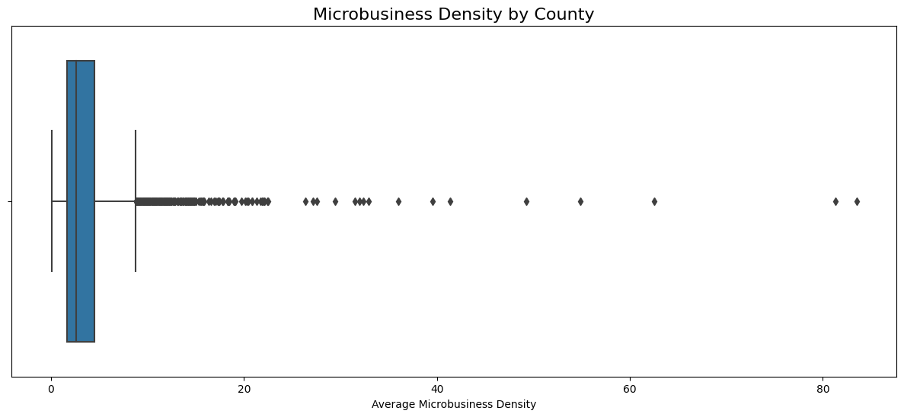
Microbusiness Density by County
Mean Microbusiness_density by county:
Min = 0.06
Max = 83.48
Median = 2.61
Q1 = 1.65
Q3 = 4.5
Carson City, Nevada: highest mean Microbusiness_density
Issaquena County, Mississippi: lowest mean Microbusiness_density
Many outliers greater than 4.5.
Skewed Right

Slide 4
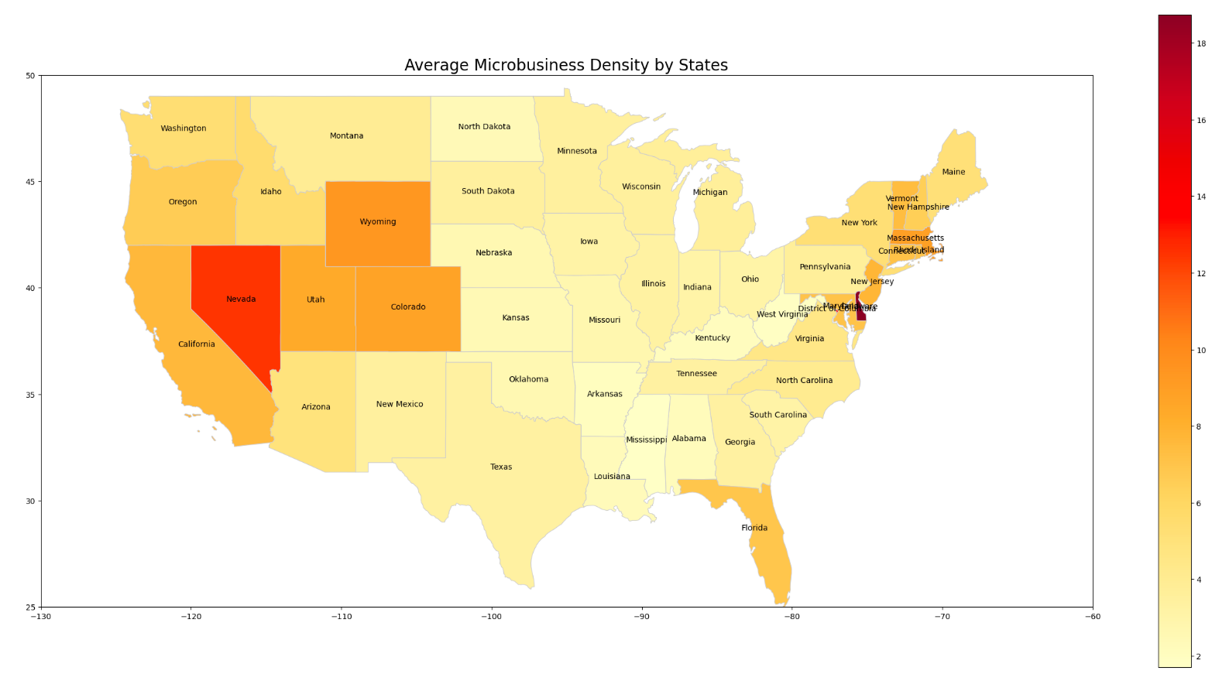
Source: https://www.census.gov/geographies/mapping-files/2018/geo/carto-boundary-file.html
States with lowest average MBD:
Mississippi 1.704932
West Virginia 1.8597
Arkansas 1.9999
States with highest average MBD:
Delaware 18.7419
District of Columbia 13.5342
Nevada 12.4262

Slide 5
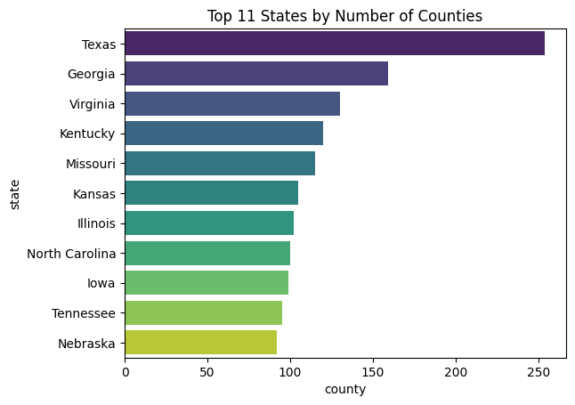
Number of Counties by State
Texas has most counties (254)
District of Columbia has fewest counties (1)
As number of counties increases, microbusiness density decreases
Bottom 3 Average MBD States are not inside Top 11
11 States with most counties

Slide 6
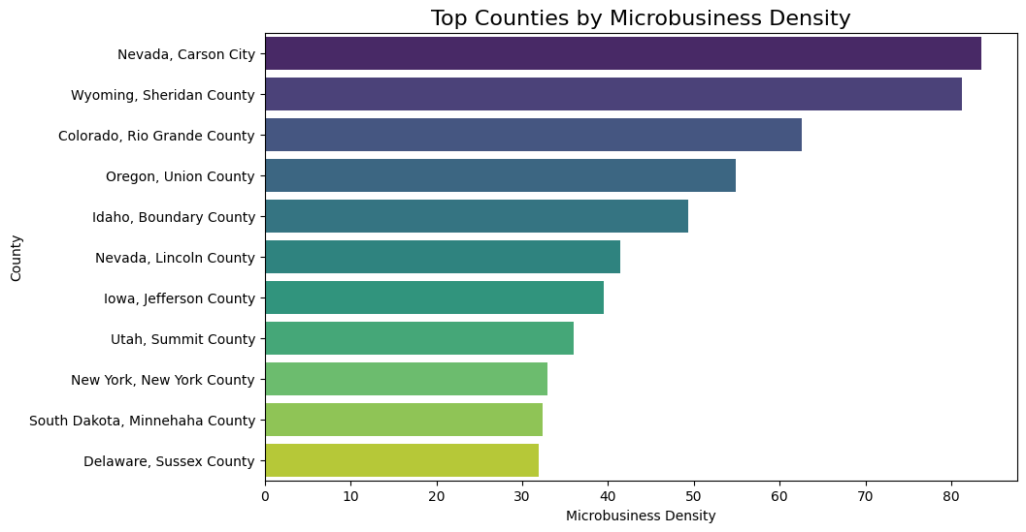
Top Counties by Microbusiness Density
Extreme MBD values in Carson city and Lincoln country (Nevada) may explain the high ranking of Nevada among states
Delaware has no county in Top 10 despite being state with highest MBD
Sussex County, Delaware: 11th-highest
Top 11 Counties with Highest MBD

Slide 7
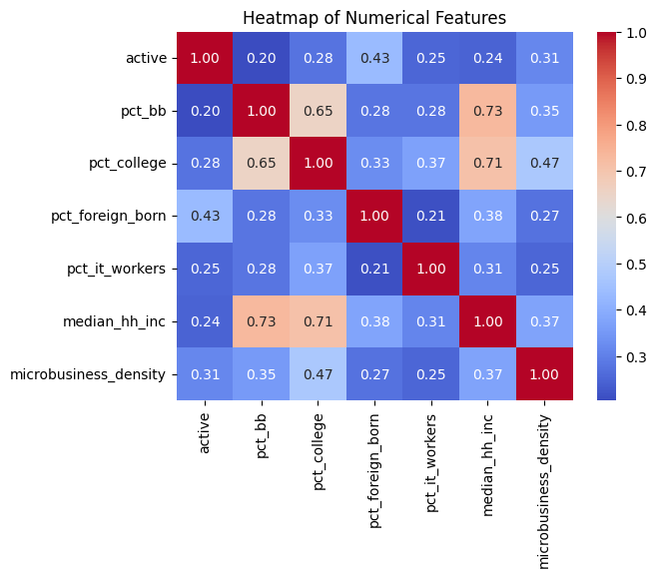
Correlation Heatmap
(pct_bb, pct_college): r=0.65
(pct_bb, median_hin_inc) r=0.73
(pct_college, median_hin_inc) r=0.71
All variables have positive correlation
Features are not highly correlated

Slide 8
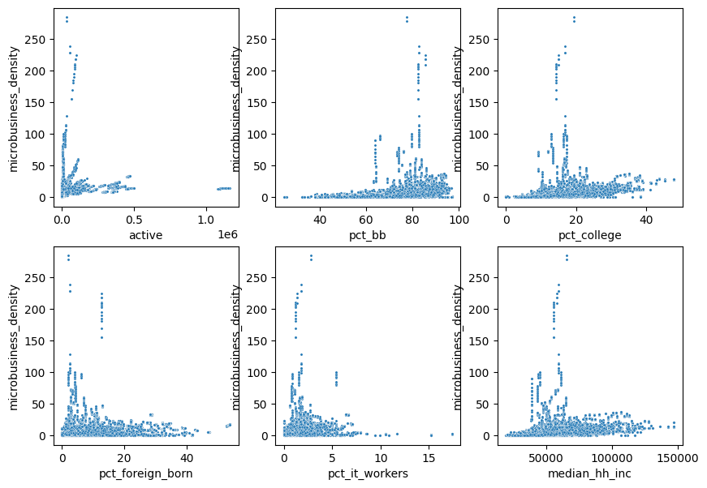
Scatterplots
Heteroscedasticity present in “active”
May drop feature before training ML models
Considerations for outliers
For all features, there exists outliers that spikes up significantly
Partitioning the counties in ways such as by size or population may be needed

Slide 9
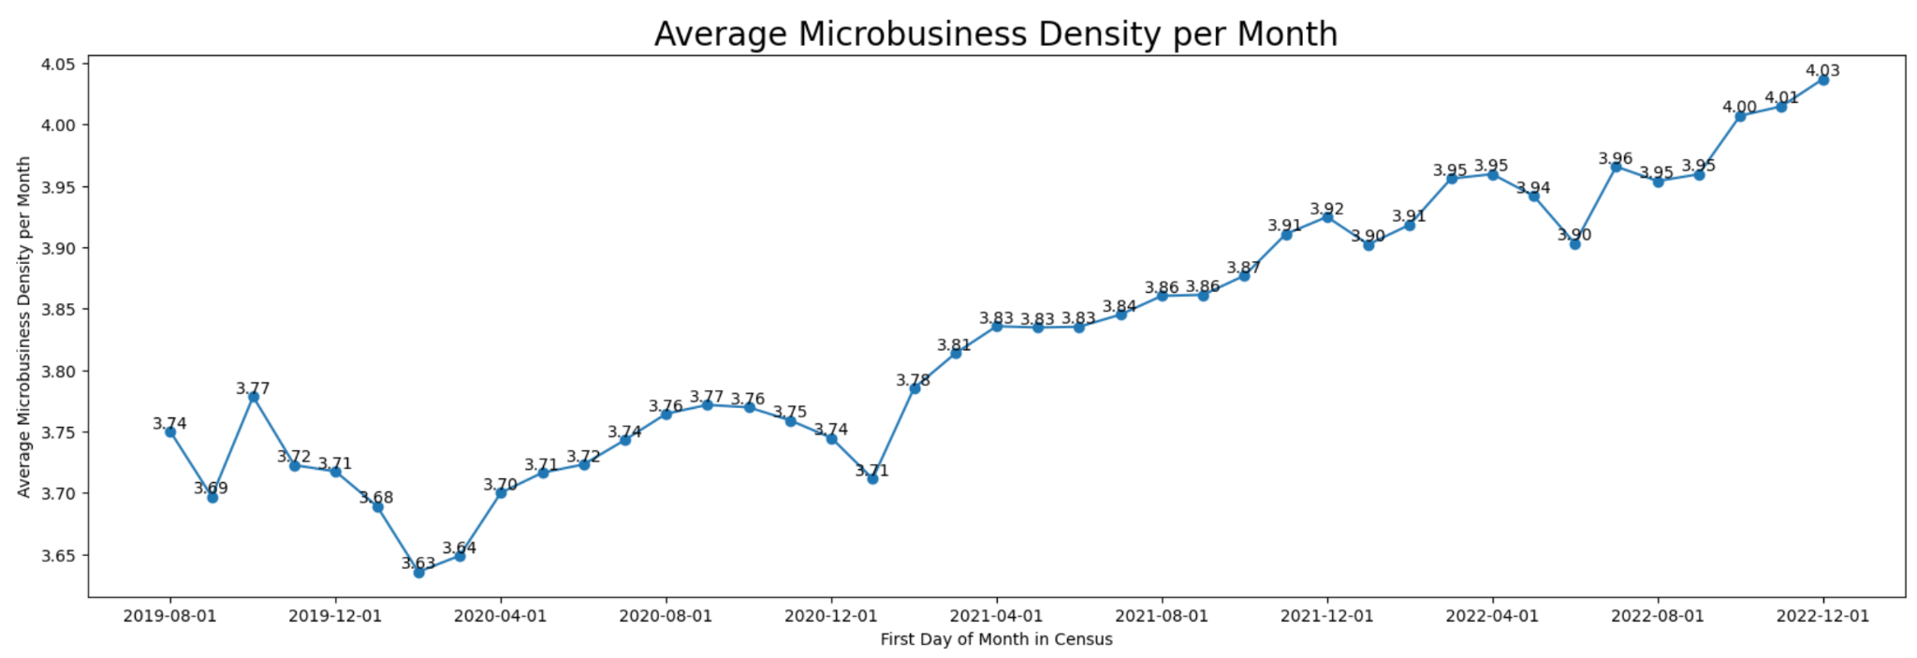
Average Microbusiness Density by Month
The trend of average Microbusiness Density per month:
From 2019 to 2022, average Microbusiness Density per month increased over time
Occasional drops, but not seasonal
Feb 2020 had the lowest average Microbusiness Density 3.63

Slide 10
Machine Learning techniques proposed to be implemented
Baseline Model: Linear Regression
Comparing L1/L2/Elastic-Net
Gradient Boosting
XGBoost
Hyperparameter Tuning
Time Series
AR/MA/ARMA/ARIMA
Evaluation Metric: MAPE
Mean Absolute Percentage Error
Used over Mean Squared Error because we care about small errors
Other Techniques
Early Stopping
Structured Splitting

